Slide 1
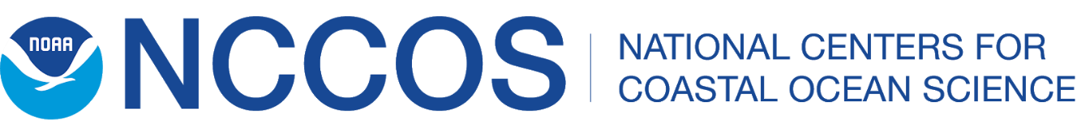
Many HABs Many Impacts
Quay Dortch
Senior HAB Scientist
Competitive Research Program

Slide 2

Talk Outline
What are HABs?
Where do they occur, especially extreme events?
What are the harmful impacts of marine HABs?
What can be done about them?

Slide 3
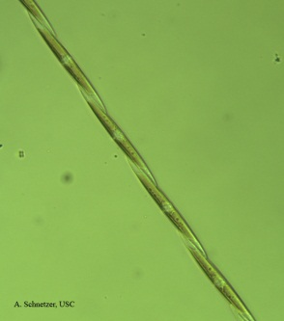
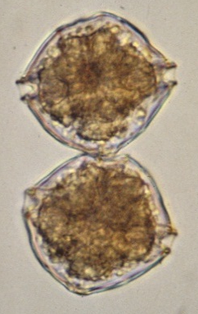
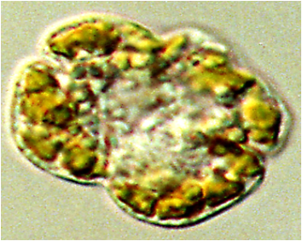
What Is a Harmful Algal Bloom?
Algae--Single-celled plants that photosynthesize (fix CO₂ and produce O₂, using sunlight)
Complications with definition
  Cyanobacteria photosynthesize but are not plants
  Many motile—flagella or other means of moving
  Some not photosynthetic
  Some can eat other organisms
  Includes macroalgae

Slide 4
What Is a Harmful Algal Bloom?
Abundance > “normal”
Some can discolor water red, brown, orange, green, purple, white, yellow, etc.
Some can be invisible
Some can have harmful effects at low abundance

Slide 5
What Makes Algae Proliferate (Bloom)?
Gains >
Loses
Growth
  Light
  Macro- & micro nutrients
  Water column stability
  Temperature
  Salinity
Life cycle stages
Oceanographic conditions
Grazing
Bacteria & viruses
Death
Allelopathy (algal biological warfare)
Life cycle stages
Oceanographic conditions

Slide 6
Bloom Stages & Toxicity
M
Bloom Stages
  Initiation
  Growth
  Maintenance
  Decline
Toxicity
  Some HABs always (NSP, PSP), sometimes (CFP, ASP), never toxic (non-case study)
  Toxicity not the only way they cause harm
  May depend on bloom stage
  May depend on environmental conditions
Cell Number
G
D
I
Time

Slide 7
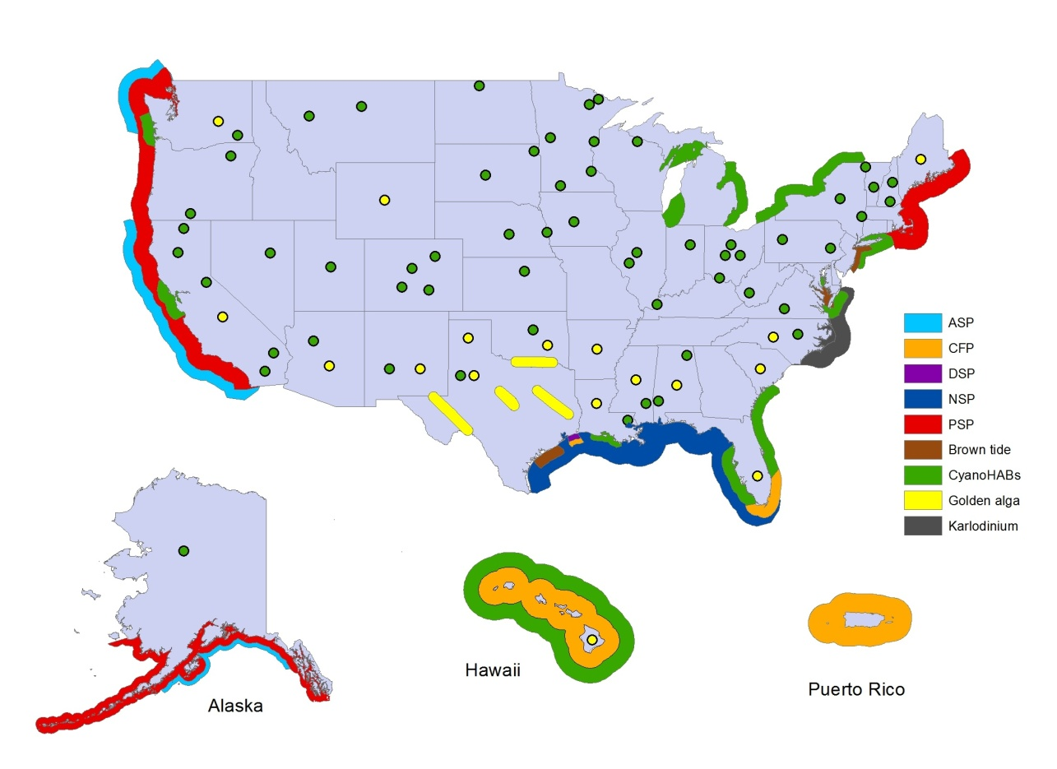
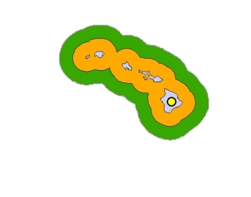
Where Do HABs Occur?
201
2015
Amnesic Shellfish Poisoning
Ciguatera Fish Poisoning
Diarrhetic Shellfish Poisoning
Neurotoxic Shellfish Poisoning
Paralytic Shellfish Poisoning
Brown tide
CyanoHABs
Golden Algae
Karlodinium
5/30/20

Slide 8
2014
2015
2014
Amnesic Shellfish Poisoning
Ciguatera Fish Poisoning
Diarrhetic Shellfish Poisoning
Neurotoxic Shellfish Poisoning
Paralytic Shellfish Poisoning
Brown tide
CyanoHABs
Golden Algae
Karlodinium
7/24/20

Slide 9
2015
2015
2015
Amnesic Shellfish Poisoning
Ciguatera Fish Poisoning
Diarrhetic Shellfish Poisoning
Neurotoxic Shellfish Poisoning
Paralytic Shellfish Poisoning
Brown tide
CyanoHABs
Golden Algae
Karlodinium
2015
7/24/20

Slide 10
2016
2015
2015
2016
Amnesic Shellfish Poisoning
Ciguatera Fish Poisoning
Diarrhetic Shellfish Poisoning
Neurotoxic Shellfish Poisoning
Paralytic Shellfish Poisoning
Brown tide
CyanoHABs
Golden Algae
Karlodinium
2016
2016
7/24/20

Slide 11
2015
2017
2015
2017
Amnesic Shellfish Poisoning
Ciguatera Fish Poisoning
Diarrhetic Shellfish Poisoning
Neurotoxic Shellfish Poisoning
Paralytic Shellfish Poisoning
Brown tide
CyanoHABs
Golden Algae
Karlodinium
2017
7/24/20

Slide 12
2015
2018
2015
2018
2018 Multiple Toxins
Amnesic Shellfish Poisoning
Ciguatera Fish Poisoning
Diarrhetic Shellfish Poisoning
Neurotoxic Shellfish Poisoning
Paralytic Shellfish Poisoning
Brown tide
CyanoHABs
Golden Algae
Karlodinium
2018
2018
7/24/20

Slide 13
2015
2015
2019
Amnesic Shellfish Poisoning
Ciguatera Fish Poisoning
Diarrhetic Shellfish Poisoning
Neurotoxic Shellfish Poisoning
Paralytic Shellfish Poisoning
Brown tide
CyanoHABs
Golden Algae
Karlodinium
2019
2016
2018
2019
7/24/20

Slide 14
201
2015
2020
2020
Amnesic Shellfish Poisoning
Ciguatera Fish Poisoning
Diarrhetic Shellfish Poisoning
Neurotoxic Shellfish Poisoning
Paralytic Shellfish Poisoning
Brown tide
CyanoHABs
Golden Algae
Karlodinium
2020
2016
2018
2020
7/24/20

Slide 15
2014
2015
2016
2017
2018
2015
2020
2014-2020
2018 Multiple Toxins
Amnesic Shellfish Poisoning
Ciguatera Fish Poisoning
Diarrhetic Shellfish Poisoning
Neurotoxic Shellfish Poisoning
Paralytic Shellfish Poisoning
Brown tide
CyanoHABs
Golden Algae
Karlodinium
2020
2012
2013
2016
2019
2015
2017-2018
2016
2018
2019
2020
7/24/20

Slide 16
Case Study Immediate Impacts

Slide 17
Case Study Immediate Impacts

Slide 18
HAB Toxins Cannot Be Destroyed by Cooking, Freezing, etc.

Slide 19
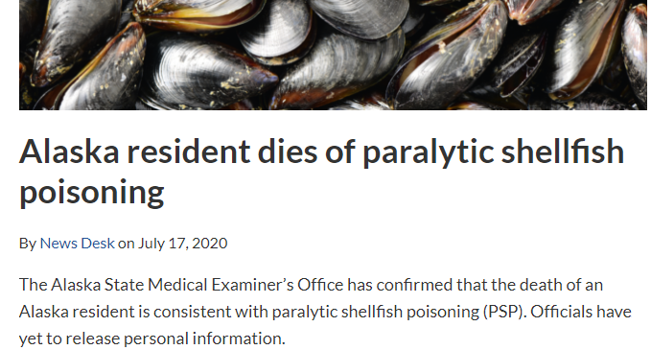
Human Toxicity Shellfish-ASP, NSP, PSP
Human illness & death
  Areas monitored
    None from commercial products in US
    Occasional illness among recreational &
    subsistence users
  Areas not monitored
    AK human death & illness recreational & subsistence users
Monitoring & regulatory structure
  Interstate Shellfish Sanitation Conference
    Molluscan shellfish
    State/tribal governments, federal agencies (FDA, NOAA, EPA), shellfish industry

Slide 20
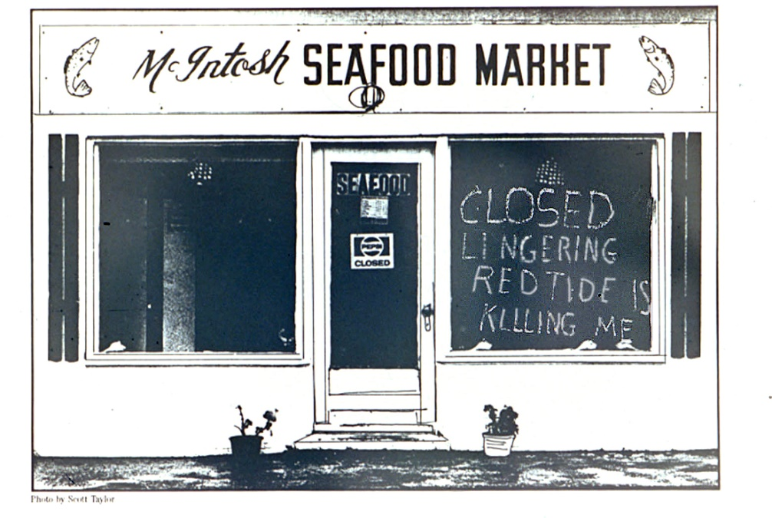
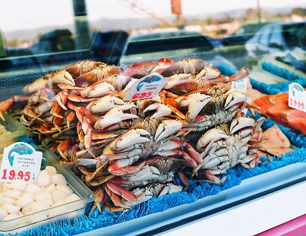
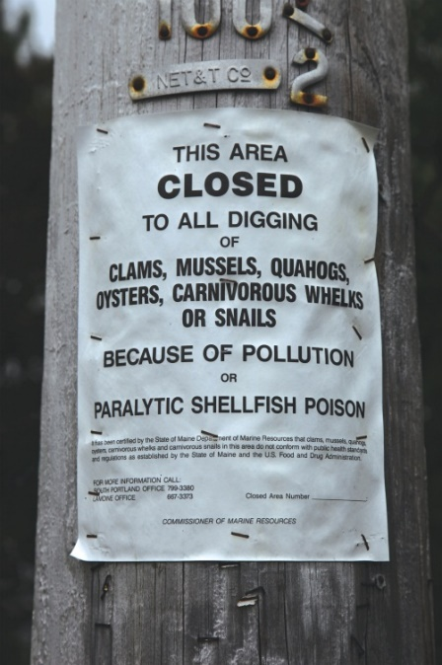
Human Toxicity Shellfish-ASP, NSP, PSP
Closures commercial, recreational, subsistence
& aquaculture harvests where monitoring occurs
  Product recalls
  Lost sales throughout shellfish industry
  Increased prices
  Increased imports
  Halo effect impacts other products
  Reduced tourism and recreation
  Loss of important source nutrition
  Social and cultural losses

Slide 21
Case Study Immediate Impacts

Slide 22
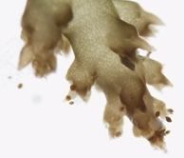
Human Toxicity Fish
CFP
  FDA and some states investigate outbreaks and sometimes issue advisories
  Most common seafood poisoning worldwide
  Prevents commercial, recreational, and subsistence fishing
  in many tropical, sub-tropical areas
ASP (Domoic Acid Poisoning, DAP)
  DA at high levels mostly in fish gut, not muscles
  2015 Pseudo-nitzschia West Coast bloom, sales filter feeding fish banned
  No known human illnesses, many marine mammal and bird deaths
NSP (Karenia brevis & others)
  Brevetoxins mostly in fish gut, not muscles
  Increased emergency room visits for gastric illness during Karenia blooms

Slide 23
Case Study Immediate Impacts

Slide 24
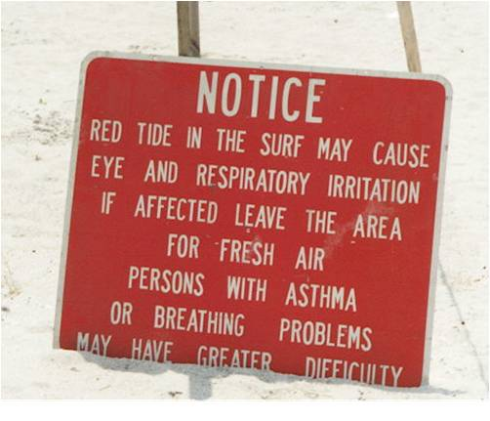
Human Toxicity Aerosols--Karenia
Human illnesses due to respiratory and neurotoxic impacts
Monitoring & models provide early warning to public & businesses
Warnings and beach closures
Reduced dive boat/charter fishing excursions
Fewer visitors parks & other recreational facilities
Fewer restaurant patrons
Less need for hotel rooms and short-term rentals
Lower real estate prices

Slide 25
Case Study Immediate Impacts

Slide 26
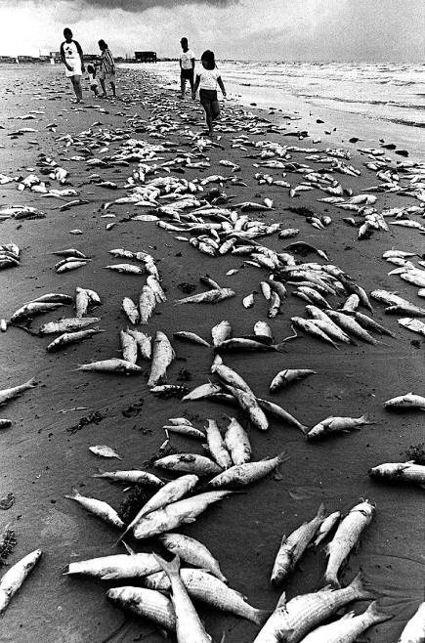
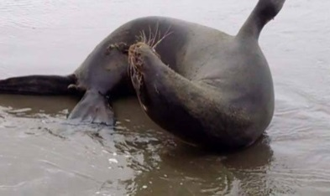
Non-human toxicity
Dead fish—NSP, PSP
  Decreased beach use
  Beach clean-up
  Accounted for in some fisheries management plans
Marine mammals, turtles, birds--NSP, ASP, PSP
  Includes many protected species
  Public concern
  Animal rescue and treatment
  Accounted for in some management plans

Slide 27
Case Study Immediate Impacts

Slide 28
Other Ecosystem Impacts
Water Discoloration—NSP, PSP
  Causes public concern
  Combined with aerosolized toxin & fish kills may impact tourism, recreation, real estate
Hypoxia—NSP
  Hypoxia & toxicity linked

Slide 29
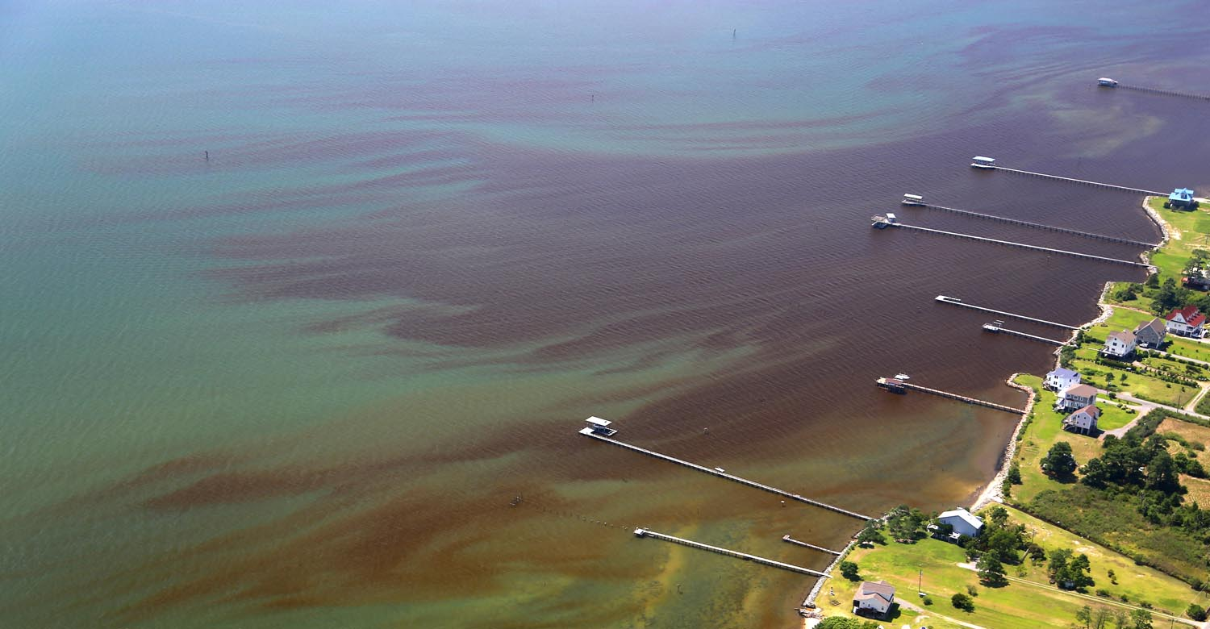
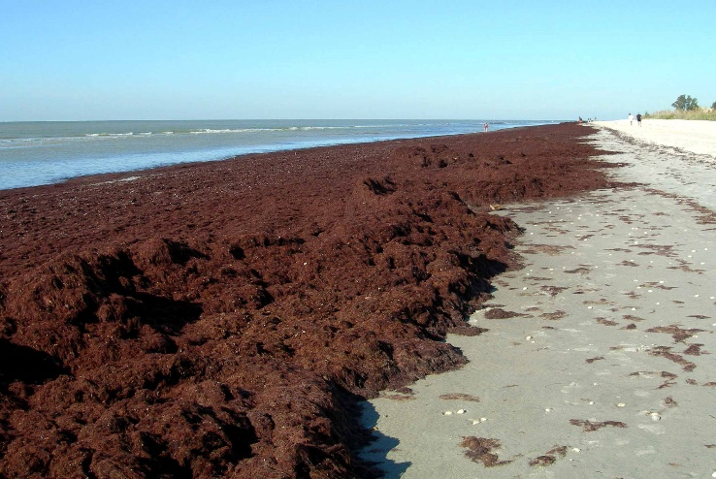
Non-Case Study HAB Impacts
Other human toxins
High Biomass
  Water discoloration—red, brown, orange
  Hypoxia
  Block light—loss SAVs
  Block light and overgrow corals—kill corals
  Pile up on beaches and accumulate in near shore shallow areas
  Poor food source
Foam production kills birds (and humans)
Toxic to fish & shellfish
  Shellfisheries recruitment failure reduces wild harvest & aquaculture
  Mass mortalities for wild & aquaculture shellfish and finfish

Slide 30
What Can Be Done?
Prevention—activities that keep the bloom from occurring or minimize the size
Control—activities that suppress or eliminate the bloom once it has formed
Mitigation—activities that reduce the impact of the bloom

Slide 31
Prevention
Many marine/estuarine HABs partially/entirely naturally occurring
Reduce nutrient inputs or modify ratios & types of nutrient runoff
Make hydrological modifications
Reduce introductions by ballast water or shellfish transfer

Slide 32
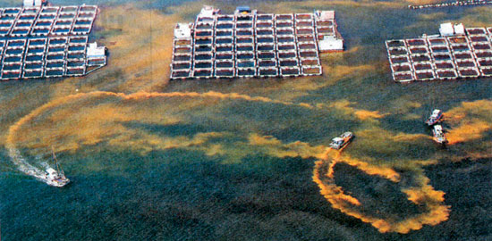
Control
Freshwater—many methods in use
Marine—few methods in development in US
  Clay dispersal--multiple variants, in use in Asia
  Taxa-specific algaecides

Slide 33
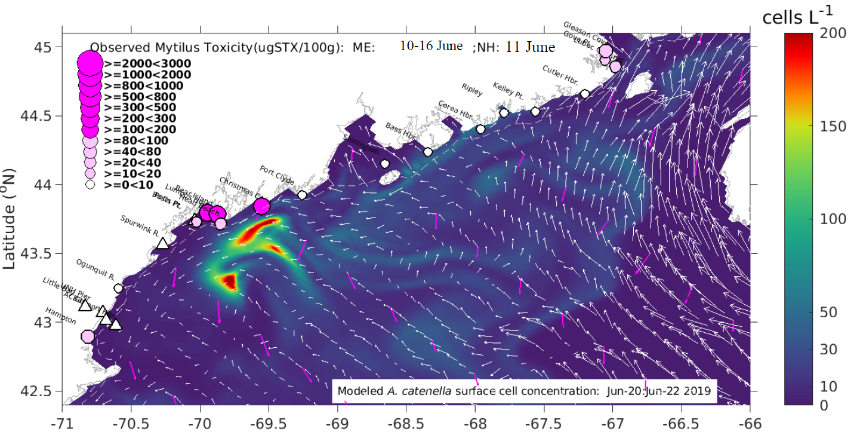
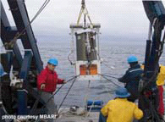
Mitigation
HAB prediction and monitoring
  Early warning
  Protect public health & minimize economic impacts
Public outreach and education
Protocols for treatment of humans and wildlife
Insurance for aquaculture to cover HABs
Financial assistance to impacted communities
  Small Business Administration loans
  NOAA Declaration of Fisheries Failures & Congressional appropriations
  HABHRCA 2017/2019 HAB & Hypoxia Events of National Significance (HHENS)

Slide 34
Conclusions
Many HABs, toxins, & impacts—generalizations difficult
Extreme events cause greatest interest in socioeconomic impacts
Congress wants a single national or specific local number for economic impacts
  No idea of complexity & lack of studies
  Have not thought about social science
US does excellent job of protecting consumers of commercial shellfish & fish from death and acute illness
  Impacts of long-term low level exposure, especially to multiple toxins, unknown
  Focus on HABs that impact human health—other HAB impacts poorly characterized
At present options for mitigation>>>control>prevention

